Slide 1
Apache Spark
Tool Talk
Ayush Kumar, Brandon Amirouche, Faisal Hossain

Slide 2
Table of Contents
01
02
03
04
Introduction
Purpose, History, Industry Usage, Architecture
Installation
Installation tutorial
Preprocessing & EA
Data loading, pre-processing, and EA demo
Data Model
Train on a dataset and produce a model

Slide 3
01
Introduction
Apache Spark

Slide 4
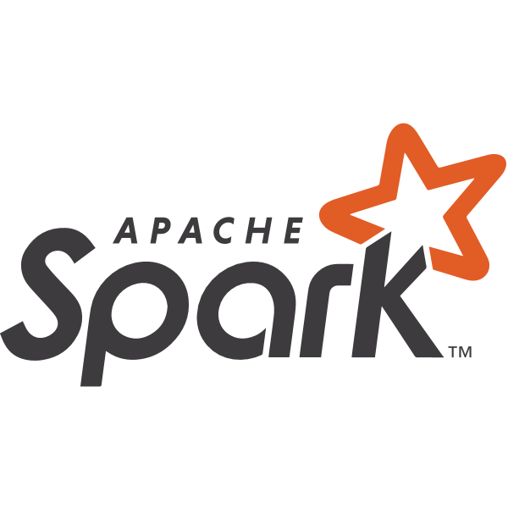
Apache Spark
Apache Spark is a data processing framework that can quickly perform processing tasks on very large data sets. Essentially, an unified analytics engine used for big data and machine learning.
Notes:
Apache Spark is a data processing framework that can quickly perform processing tasks on very large data sets, and can also distribute data processing tasks across multiple computers, either on its own or in tandem with other distributed computing tools.
History
Apache Spark originally started in 2009 by a research team in UC Berkeley Now, Apache Spark has become the largest open source project in data processing, with over 1000 contributors from 250+ organizations.

Slide 5
Benefits
Speed
Ease of Use
A Unified Engine
Spark can be 100x faster than Hadoop for large scale data processing by exploiting in memory computing and other optimizations.
Spark has easy-to-use APIs for operating on large datasets. Includes 100+ operators for transforming & manipulating
Spark comes packaged with higher-level libraries, including support for SQL queries, streaming data, machine learning and graph processing.
Notes:
Apache Spark is a popular tool among the industry because of its speed, ease of use, and generality - allowing it to become one of the key big-data processing frameworks in the world. Spark can be deployed in a variety of ways and offers over 80 high-level operators that make it easy to build parallel apps. You can use it conveniently and interactively from the Scala, Python, R, and SQL shell.

Slide 6
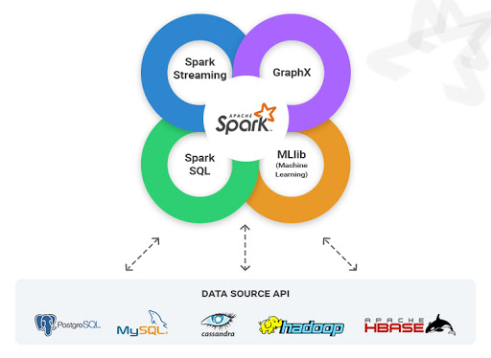
Community / Industry Usage
Apache Spark is built by a wide set of developers from over 300 companies. Since 2009, more than 1200 developers have contributed to Spark.
Notes:
Because of Apache Spark’s benefits - You’ll find it used by banks, telecommunications companies, games companies, governments, and the major tech giants such as Apple, Facebook, IBM, Netflix, and Microsoft.

Slide 7
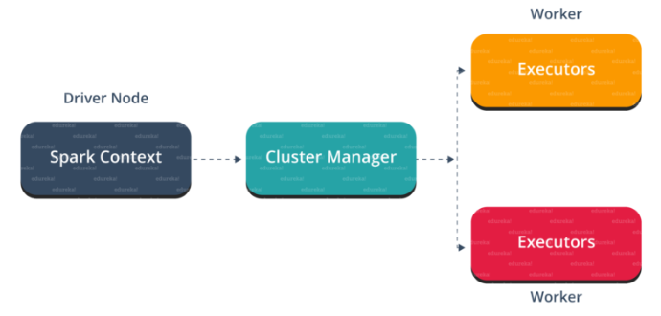
Architecture
Apache Spark Architecture is based on two main abstractions:
Resilient Distributed Dataset (RDD)
Directed Acyclic Graph (DAG)
Notes:
Apache Spark Architecture
At a fundamental level, an Apache Spark application consists of two main components: a driver, which converts the user's code into multiple tasks that can be distributed across worker nodes,
and executors, which run on those nodes and execute the tasks assigned to them.
Some form of cluster manager is necessary to mediate between the two.
Apache Spark builds the user’s data processing commands into a Directed Acyclic Graph, or DAG. The DAG is Apache Spark’s scheduling layer; it determines what tasks are executed on what nodes and in what sequence.

Slide 8
02
Installation
Apache Spark

Slide 9
Installation (MAC)
using Homebrew
Install Java
Install Scala
01
02
$ brew cask install java
$ brew install scala
Install Apache Spark
Start Spark Shell
03
04
$ brew install apache-spark
$ spark-shell
Notes:
Apache Spark Installation
Homebrew
Homebrew is a free and open-source software package management system that simplifies the installation of software on macOS as well as Linux. Homebrew is written in the Ruby programming language and targets the version of Ruby that comes installed with the mac operating system. The package manager builds software from source using "formulae", Ruby scripts constructed with Homebrew's (DSL) domain-specific language for managing dependencies, downloading source files, and configuring and compiling software.

Slide 10
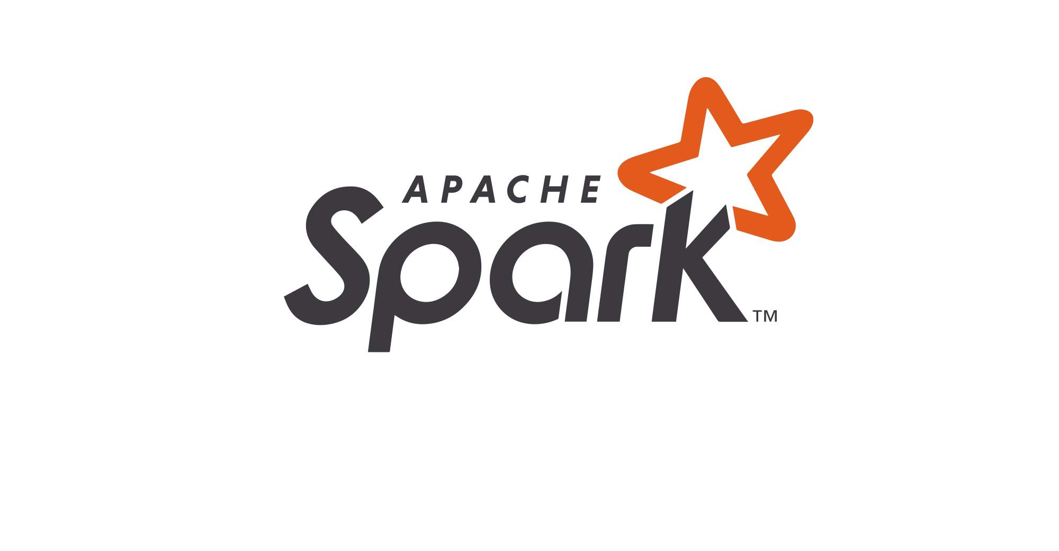
Thanks!
Do you have any questions?
Please keep this slide for attribution

